Slide 1


Final Presentation – Part B
Picture Manipulation using Hardware
10.06.2013
Dual-semester project
Presents by- Uri Tsipin & Ran Mizrahi
Supervisor– Moshe Porian

Slide 2
Agenda
Intro – Problem, Project’s goals, Algorithm
Previous System – Explained
New Top Architecture – Additions and modifications
µArchitucture- components description, simulations and testing
GUI
Testing
Problems during the project
Conclusions

Slide 3
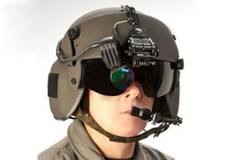
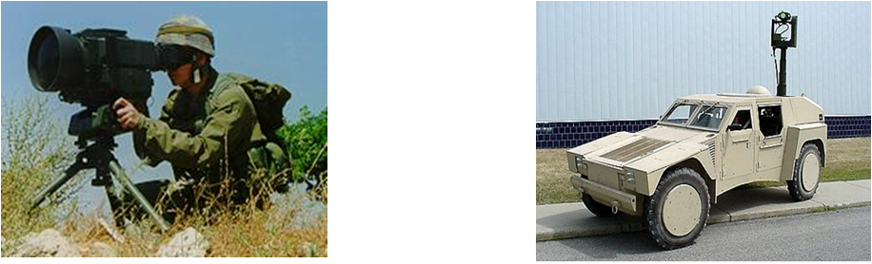
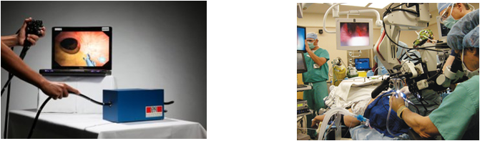
Intro
Many military and civilian application use image manipulation as an integral part of their function
Helmet mounted displays
Medical procedures
Army surveillance gear

Slide 4

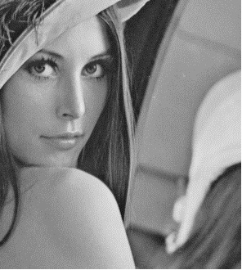
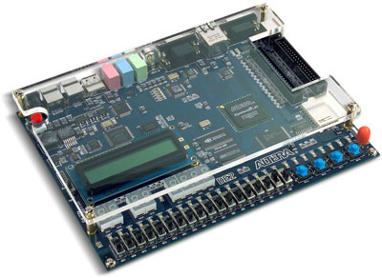
Problem
Image Processing algorithms such as:
Image Rotation
Zoom
Crop Image
which implemented by software are:
Slow
Heavy power consumers
Large space consumers
Solution
Hardware implementation of the algorithms
using Board with FPGA and External Memory

Slide 5
Project’s Goals
Implement the following algorithms using FPGA:
Full panoramic rotation: 0 to 360 degrees
Support of Zoom function
Support of Crop-Image function
Minimum image distortion

Slide 6
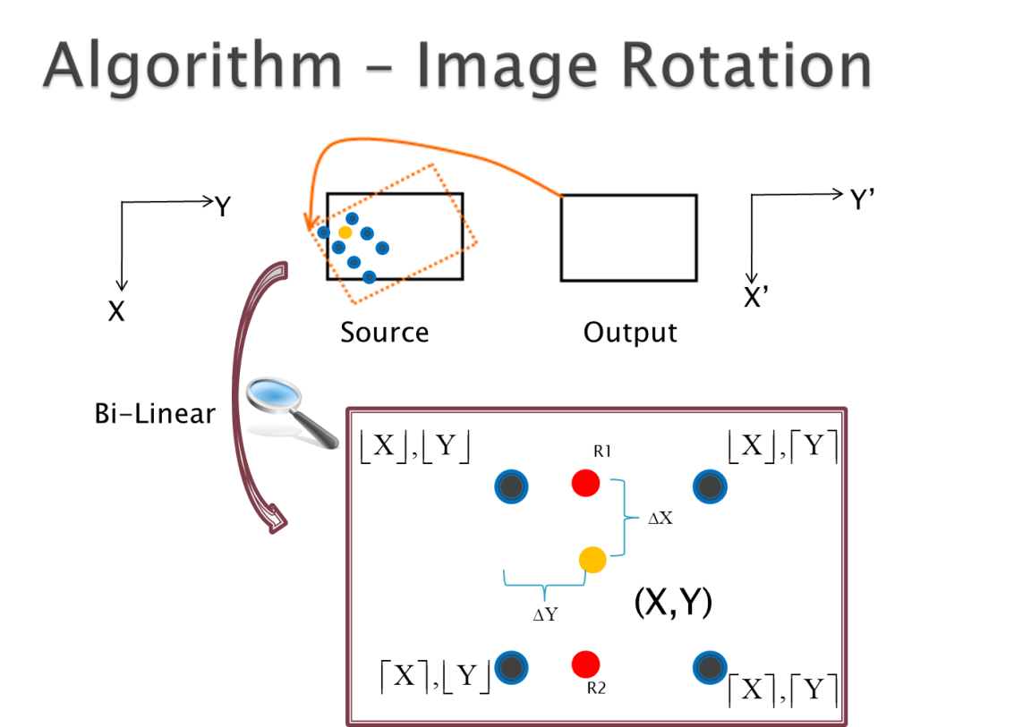
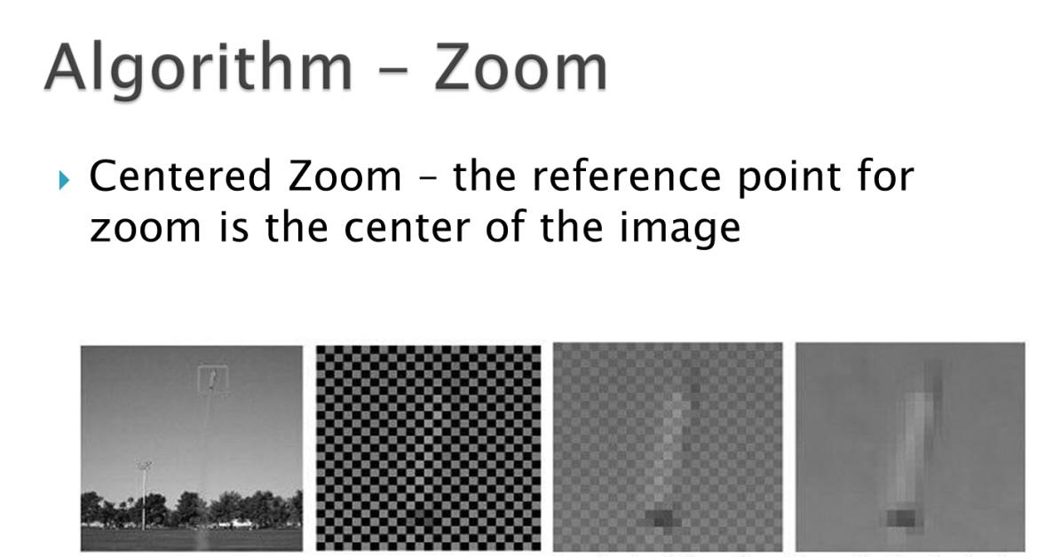
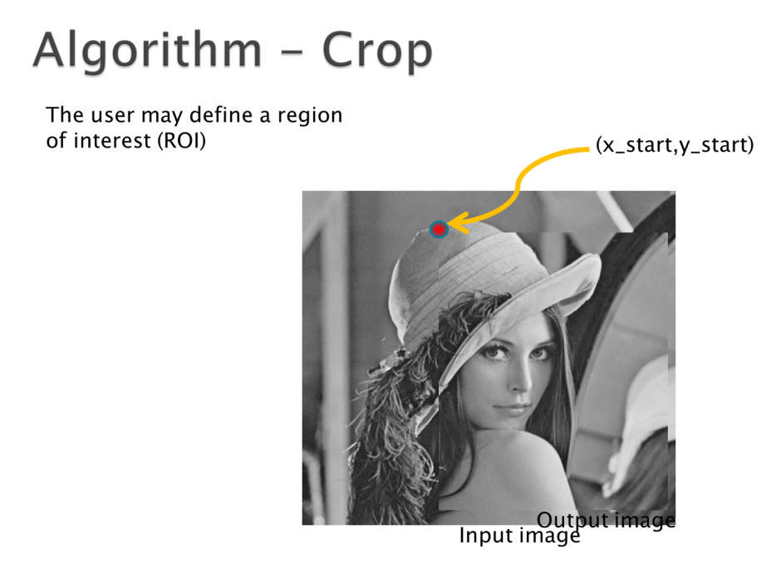
(x_start,y_start)
Input image
Notes:
Zoom – ככל הנראה ימומש עבור חזקות של 2 ז"א 2,4,8
Crop – המשתמש יתן קורדיטת עניין שמתארת את הפינה העליונה של התחום עניין
כרגע כל האלגוריתמים ממומשים בתוך החישוב של הכתובת של פיקסל השערוך,
אנחנו עדיין צריכים לבדוק אם המימוש החומרתי של הסיפור יבוצע בדיוק באותו האופן

Slide 7
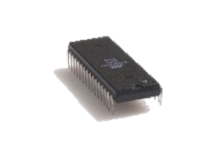
Top Architecture – Previous System
UART
RX Path
TX Path
UART
WBS
WBM
WBM
Host
(Matlab)
Wishbone
INTERCON
WBS
Memory
Management
WBS
Display
Controller
WBS
WBM
WBM
VGA
Display
IS42S16400 SDRAM
WBS
SDRAM Controller
VESA
Notes:
ארכיטקטורה מפרויקט של סטודנטים מהפקולטה משנה שעברה.
המערכת לוקחת תמונה דחוסה שמקודדת בRUNLENGTH (מה שלא ייקרה אצלנו)
כותבת אותה דחוסה לתוך הזכרון
קוראת אותה מהזכרון , פורסת אותה ומציגה אותה למסך.

Slide 8
Problems during the process
Making the system support low resolutions:
Debugging the current system in order to learn the data flow, components, processes.
Changing generics in code
Making the system support non compressed image
Removal unnecessary components
Change the matlab output.

Slide 9
Top Architecture – New
UART
RX Path
TX Path
UART
WBS
WBM
WBM
Host
(Matlab)
Wishbone
INTERCON
WBS
Memory
Management
WBS
Display
Controller
WBS
WBM
WBM
WBS
Image Manipulation
VGA
Display
IS42S16400 SDRAM
WBS
SDRAM Controller
WBM
VESA

Slide 10
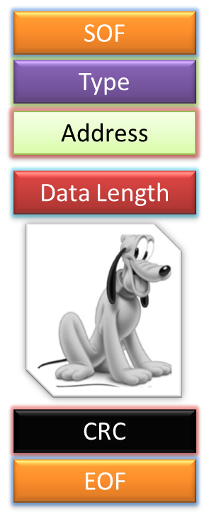

Data Flow - Ilustration
UART
RX Path
TX Path
UART
WBS
WBM
WBM
Host
(Matlab)
Wishbone
INTERCON
WBS
Memory
Management
WBS
Display
Controller
WBS
WBM
WBM
WBS
Image Manipulation
VGA
Display
IS42S16400 SDRAM
WBS
SDRAM Controller
WBM
VESA
Notes:
תרשים זרימת מידע

Slide 11
Image Manipulation – New Block
Parameter registers- holds user parameters (angle,zoom,crop)
Address Calculator – Calculates "matrix address" of 4 pixels that are required for the bilinear-interpolation and converts the "matrix address" into a 1D SDRAM address
Bilinear Interpolator – Calculates a mean average between 4 pixels
Image Manipulation Manger – Controller for the block
Internal RAM- 1 KB
WBM/WBS- top block interfaces
Image Manipulation
WBS
Addr Calculator
Param Registers
WBM
Biliniar
TYPE
Reg
ImgMan Manger
ReadProc
WriteProc
WBM
RAM
Notes:
על מנת לסובב תמונה נדרשים 4 פקסלים מתמונת המקור.
כל פיקסל נקרא בנפרד – תחילה מחושבת הכתובת המטריצית של הפיקסל הדרוש (מתוך הארבעה)
לאחר מכן הכתובת מומרת לכתובת SDRAM (יכול להיות ששני הרכיבים יאוחדו לרכיב אחד)
לאחר מכן מתבצעת קריאה מהזכרון של ערך הפקסל,
חוזר על עצמו 4 פעמים עד אשר יש לנו ארבעה פקסלים לביצוע אינטרפולציה בי-לינארית
מבוצעת אינטרפולציה וערך הפיקסל החדש נכתב לבנק חדש בזכרון שיכיל את התמונה המסובבת

Slide 12
Parameter Registers
WBS
Param Registers
WBM
Addr Calculator
Biliniar
TYPE Reg
ImgMan Manger
WBM
ReadProc
WriteProc
RAM
New registers were added to the system in order to hold the user parameters, which are required for image manipulation.
Registers addresses were expanded to 5bit addresses (up-to 32 registers)
Register's name | Address | Size (bytes) | Purpose | Place
x_start_reg | E | 2 | X crop coordinate | Img_man_top
y_start_reg | 10 | 2 | Y crop coordinate | Img_man_top
zoom_reg | 12 | 2 | Zoom ratio | Img_man_top
cos_reg | 14 | 2 | Cosine of rotation angle, multiplied by 0x100 | Img_man_top
Sin_reg | 16 | 2 | Sine of rotation angle, multiplied by 0x100 | Img_man_top

Slide 13
Address Calculator
WBS
Param Registers
WBM
Addr Calculator
Biliniar
TYPE Reg
ImgMan Manger
WBM
ReadProc
WriteProc
RAM
Main Goal – Calculates "matrix address“
of 4 pixels that are required for the bilinear-interpolation.
Method - Given a current pixel index in the output image, the unit will calculate the origin addresses of the pixel, by the following formula:
Inputs:
User parameters (zoom factor, sin/cos[angle], crop indexes)
Row/Col index (current calculating coordinate)
Outputs:
TL,TR,BL,BR coordinate address
Delta Row, Delta Col- holds the weight for billinear interpolation.
Out of range
Valid,Finish

Slide 14
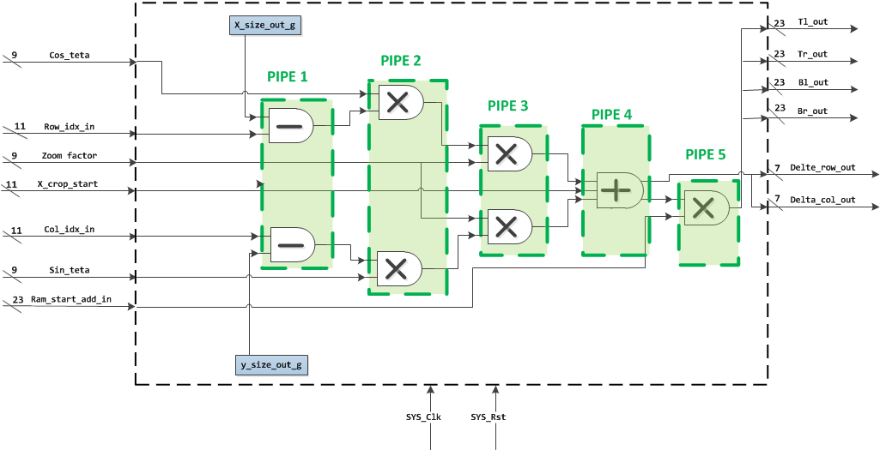
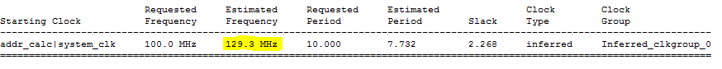
Addr. Calc. - Improved µArchitucture
WBS
Param Registers
WBM
Addr Calculator
Biliniar
TYPE Reg
ImgMan Manger
WBM
ReadProc
WriteProc
RAM

Slide 15
Addr. Calc. – working with fractures
Image Manipulation
manager
Addr_calc
Biliniar
WBM
WBS
registers
Requested decimal accuracy – 2 digits [0-0.99]
in order to work with std_logic_signals(binary) (fixed/float types experience synthesis problems)
all signals were multiplied by 2^7=128 (2^6=64-> not enough accuracy)
Example (user param.)
Zoom=x4
Angle =60 deg
X Start =30
Y Start =29
Zoom_factor=(1/zoom)*128=32
Angle =cos(60)=0.5*128=64 X/Y Start – remain the Same, no fracture required
x128

Slide 16
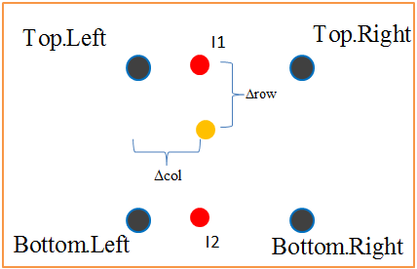
Bilinear Interpolator
WBS
Param Registers
WBM
Addr Calculator
Biliniar
TYPE Reg
ImgMan Manger
WBM
ReadProc
WriteProc
RAM
Main Goal – Calculates the mean average of 4 given gray-scale values.
Formula –
Inputs
4 pixels, 8bit grey scale
Weight fraction (row/col)
Outputs
Result pixel (the mean average of the input)
Valid signal

Slide 17
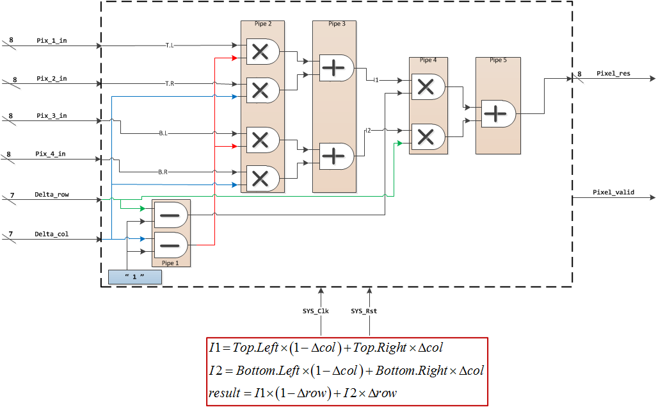
Bilinear Interpolator – µArchitucture
WBS
WBM
Param Registers
Addr Calculator
Biliniar
TYPE Reg
ImgMan Manger
WBM
ReadProc
WriteProc
RAM

Slide 18
Image Manipulation Manager –(1)
WBS
Param Registers
WBM
Addr Calculator
Biliniar
TYPE Reg
ImgMan Manger
WBM
ReadProc
WriteProc
RAM
Main Goal – Control the data flow within the image manipulation block and send Read/Write requests to other units using the wishbone protocol
Method – the controller is implemented via a several FSM’s.
Enable output for display

Slide 19
Image Manipulation Manager – Main Features
WBS
Param Registers
WBM
Addr Calculator
Biliniar
TYPE Reg
ImgMan Manger
WBM
ReadProc
WriteProc
RAM
RAM- internal RAM which stores results before write-back to SDRAM. Burst RAM size is generic- 1024 bytes.
Top FSM- controls the data flow between inner units and the main system.
Read FSM- controls the read process, sub-phase to the top FSM.
Write FSM- controls the write process, sub-phase to the top FSM. Writes the RAM contents to SDRAM.

Slide 20
Image Manipulation Manager – Interfaces
WBS
Param Registers
WBM
Addr Calculator
Biliniar
TYPE Reg
ImgMan Manger
WBM
ReadProc
WriteProc
RAM
WBM_rd- interface for read purposes.
WBM_wr- interface for write purposes.
WBS- interface for writing to parameter registers.
Notes:
היה צריך 2 WBM כיוון שכל אחד מהם מתחבר ל-WBS אחר ב-MEMORY דרך INTERCON שונה.
לצבוע את הבלוק הרלוונטי לפי BULLET

Slide 21
Image Manipulation Manager - µArchitucture
WBS
Param Registers
WBM
Addr Calculator
Biliniar
TYPE Reg
ImgMan Manger
WBM
ReadProc
WriteProc
RAM
ImgMan Manger
TOP FSM
Coordinate Process
Address Calculator Process
Read FSM
Write FSM
Bilinear Process
Generic RAM
(1024 Bytes)

Slide 22
Img. Man. Manager - FSM
WBS
Param Registers
WBM
Addr Calculator
Biliniar
TYPE Reg
ImgMan Manger
WBM
ReadProc
WriteProc
RAM

Slide 23
Test Benches
Purpose- test functionality of the IMG_MAN new block, debug problems during integration
Implementation- Matlab, text files from ModelSim

Slide 24
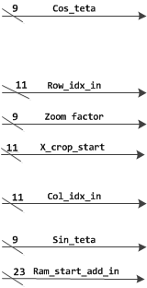
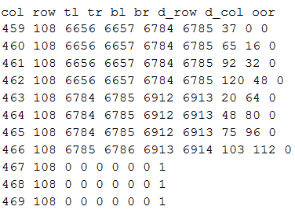
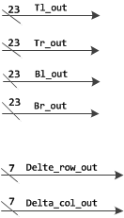
Test Bench (1)- ADDR_CLAC
ModelSim generates txt file with the calculated addresses
Output.txt
Addr_calc_tb
Addr_calc
Output 1,1
1
600
Output 1,2
Output 1,3
.
.
.
.
1
2
3
800
Output 600,800

Slide 25
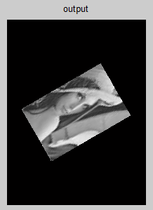


Test Bench (1)- ADDR_CLAC cont.
Using Matlab, the output image is created
Zoom=x4
Angle =60 deg
X Start =30
Y Start =29

Slide 26

Test Bench (2)- IMG_MAN
ModelSim generates txt file before/after writing back the pixels values to internal RAM, in order to make sure the new block is correct
Image Manipulation
WBS
Addr Calculator
Param Registers
WBM
Biliniar
TYPE
Reg
ImgMan Manger
WBM
ReadProc
WriteProc
RAM

Slide 27
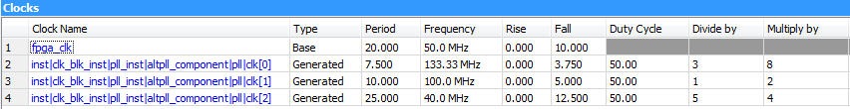
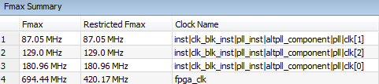
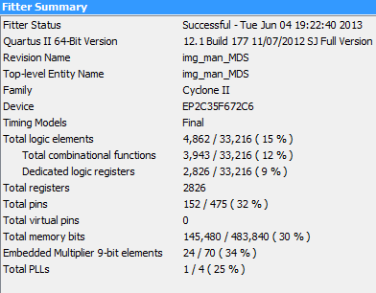
Synthesis, P&R
System Timing Results
Latency- time from end of transmission to end of manipulation- 435422720 ns,
or 0.4354 sec.
At 100 MHz: 43542272 cycles

Slide 28
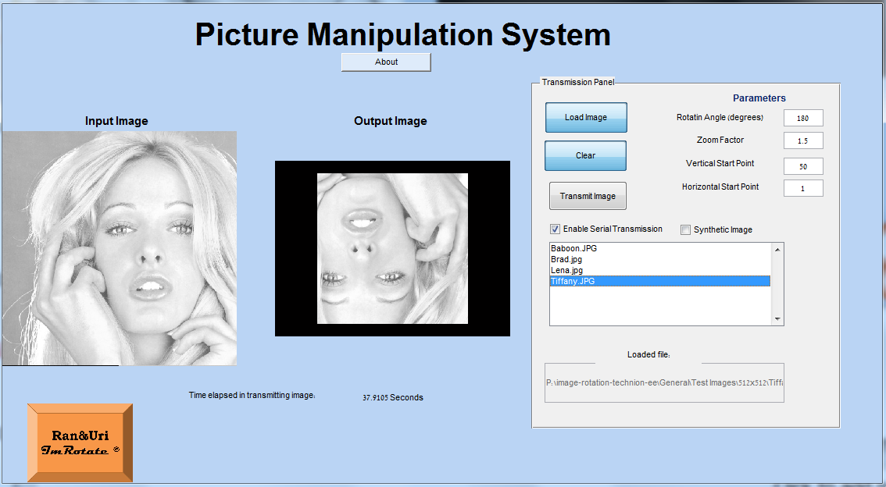
GUI
Set Parameters
Load image
Make sure Transmission enabled
Click to transmit
Select image
Expected Output
Debug option – synthetic image
Transmission time

Slide 29
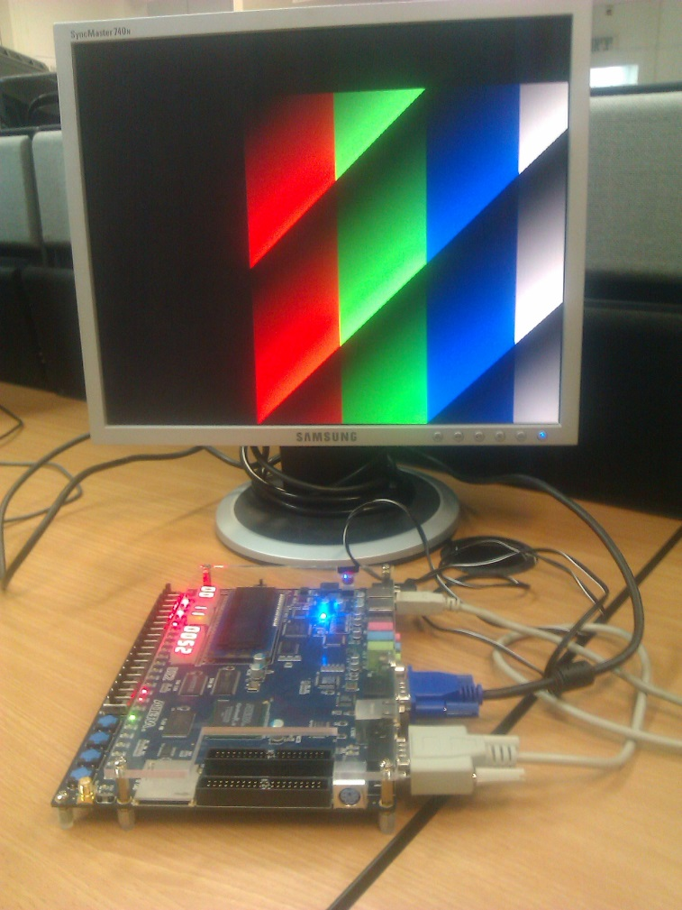
Debugging in Lab – Synthetic Generator

Slide 30
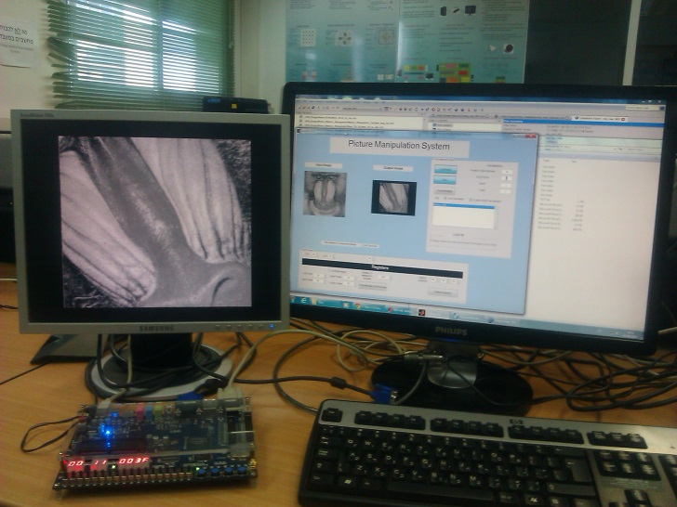
Lab Testing
Display
GUI
DE2
PC

Slide 31
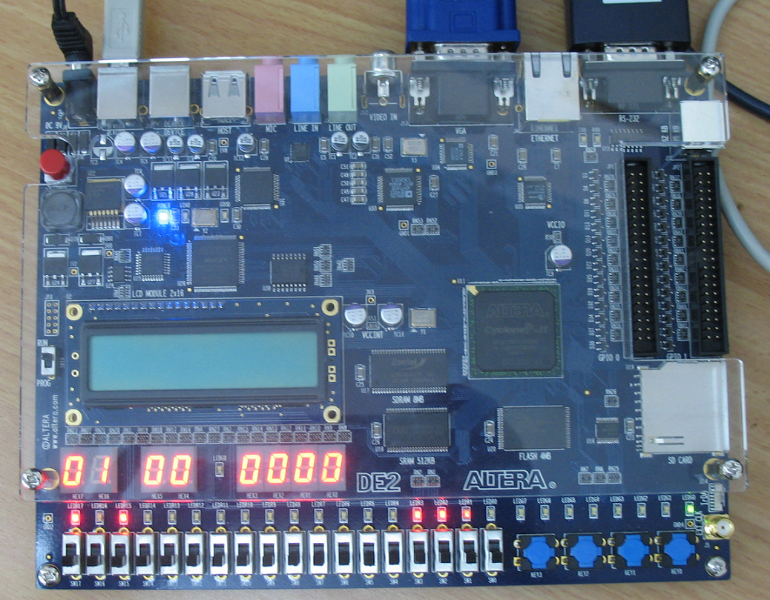
Debugging in Lab
Uart Serial out
Mem Type Reg
DBG MSB REG
Sine Reg

Slide 32
Main milestones
Learn previous system
Degenerate system to project goals
Build new block, functional TB, interfaces to main system (Wishbone protocol)
Integrate the new block with main system
TB and debugging

Slide 33
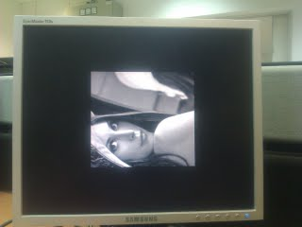
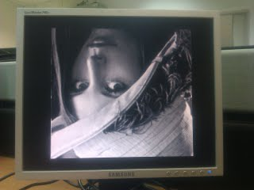
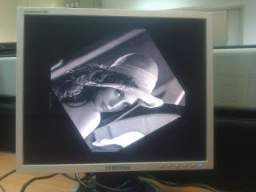
Test results
333[deg] | 180[deg] | 90[deg]
zoomx1.5 | zoom x2 | Zoom x1
Start Point [1,1] | Start Point [1,1] | Start Point [200,200]

Slide 34

Working methods
Top down design
Pipeline
Test bench
Results comparison with Matlab (Notepad++ plugin)
Components documenting
Working on lower resolution during simulations
design with generics parameters (change resolution)
Synchronize files via SVN.
Notes:
התכן נעשה על ידי בחינה של המערכת הכוללת, לאחר מכן תכן של הבלוק שלנו ואז בוצע תכן לכל רכיב בתוך הבלוק
האלגוריתם כולל חיושבים אריתמטיים עם הכפלות מרובות, והיות והכפלה הינה צרכן משאבים, פיצול החישוב משפר את הקצב התוצאות
בדיקת הרכיבים נעשתה על ידי יצירת קובץ TB לכל קומפוננטה, שמטרתו לדמות כניסות אפשריות למערכת ובדיקת התוצאות
בדיקת התוצאות נעשה מול האלגוריתם שרץ בסביבת MATLAB, השוואה עם פלט ויזואלי
תיעוד לאורך התהליך עזר בבננית המצגת, מסמך הפרויקט ולשימוש חוזר בעתיד
מאפשר עבודה מנקודות קצה שונות ושחזור במקרה של באגים

Slide 35

Problems during the process (1)
Working with fractures
First version of addr_calc used fixed point package.
Problem occurred during synthesis.
Solution- work with regular std_logic_Vector, with relevant adjustments.

Slide 36
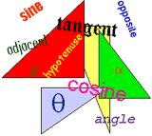

Problems during the process (2)
Trigonometric calculations (sine, cosine)
planed to be executed by VHD process, consumes expensive hardware resources.
Solution- calculate Cos/Sin by software (Matlab).

Slide 37

Problems during the process (3)
Timing issues- synthesis timing results did not meet the requirements.
solution- break arithmetic calculations into parts (piping).

Slide 38

Problems during the process (4)
Resolution issues- high resolution simulations takes more than 3 hours.
solution- working with lower resolution and diagnose the errors before high resolution simulations.

Slide 39
Problems during the process (5)
Resolution issues- failed passing simulations while upgrade to high resolution. Even though generics were used, it was hard to detect the specific errors.
solution- update VHDL generics (on the main system-Pixel manager), update counters.

Slide 40
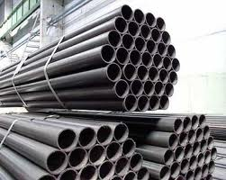
Conclusions/lessons (1)
Pipeline makes the throughput shorter. With “heavy” calculations, it is recommended to break the arithmetic process.

Slide 41

Conclusions/lessons (2)
Working with generics parameters make the design more flexible.

Slide 42
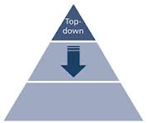
Conclusions/lessons (3)
Top down design divides the coding procedure into stages, allows more than one person to work on solution, allows parallel work.

Slide 43
Time Table – 2012-2013
Month
Project Start | November 2011
Mid Final Part A | January 2012
Final Part A | November 2012
Planed Final Part B | March 2013
Final Part B | June 2013
3 months delay

